Slide 1





AI Chatbot Using ChatGPT
Team :Hariharan.b
Email:hharandgl1967@gmail.com
Guide:P.Raja (Master trainer of edunet)
Disclaimer: The content is curated for educational purposes only.
Notes:
Slides: Prepare a short slide deck (10-12 slides) summarizing the project objectives, methodology, and key results.

Slide 2
OUTLINE
Abstract of the Project
Problem Statement
Proposed Solution
System Architecture
Live Demo of the Project
Embedded Video of Project
Conclusion
Future Scope

Slide 3
Abstract
This project explores the development and deployment of an intelligent conversational agent using OpenAI's ChatGPT, a state-of-the-art language model based on the GPT-4 architecture. Leveraging natural language processing (NLP) and deep learning, ChatGPT can understand and respond to human input in a conversational style, offering versatile applications in customer service, virtual assistance, education, and more.
The primary objective of this project is to design a chatbot that can engage users with coherent and contextually relevant responses while adapting to diverse conversation flows. By harnessing ChatGPT’s capabilities, we address key challenges in chatbot development, including natural language understanding, response generation, and maintaining contextual awareness over extended dialogues. This project also explores integrating ChatGPT with external APIs for task automation and personalizing user interactions by tailoring responses based on user-specific data.

Slide 4
Problem Statement
In today’s digital landscape, organizations face increasing demand for real-time, responsive communication with users, clients, and employees. Traditional customer service models, which rely heavily on human agents, can be inefficient, costly, and challenging to scale. Users expect fast, accurate, and personalized responses to their queries across multiple platforms and at any time of day. Meeting these expectations with human resources alone often leads to long response times, high operating costs, and inconsistencies in service quality.
This project addresses the need for an intelligent, automated chatbot that can engage in meaningful, contextually aware conversations, providing users with instant support and information. By leveraging OpenAI’s ChatGPT model, the proposed chatbot will be capable of understanding user intent, generating coherent and relevant responses, and adapting to different conversation flows without human intervention.

Slide 5
Proposed Solution
To build an effective AI chatbot, start by defining its purpose and scope. Use natural language understanding (NLU) to interpret user intent, design clear dialogue flows, and integrate a knowledge base for accurate responses. Add API connections for real-time data and personalize interactions through context management. Continuously improve with feedback, testing, and performance monitoring, and ensure security by following data protection standards. Deploy on preferred channels, plan for scalability, and evaluate success through user metrics to guide future enhancements. This approach ensures a user-centered, responsive, and scalable chatbot

Slide 6
System Architecture
1. User Interface Layer (Front-End)
Channels: Supports interaction across multiple platforms (web, mobile app, social media).
2. Conversation Engine (Core Backend)
Natural Language Understanding (NLU) Module: Uses machine learning models (e.g., transformer-based or Rasa) to detect intents, classify user inputs, and extract entities.
3. Knowledge Base and Database Layer
Knowledge Base: Stores predefined answers and FAQs. Integrated with the backend for quick retrieval.
Database: Stores conversation logs, user data (with encryption), and interaction history for personalization.
4. Integration Layer
External APIs: Provides connections to CRMs, calendars, or third-party applications to enable specific functionalities like account updates or reservations.
5. Monitoring and Analytics Layer
Performance Monitoring: Tracks response times, errors, and usage statistics to ensure reliability
6. Deployment and Scaling Infrastructure
Cloud-Based Infrastructure: Ensures scalability and fault tolerance, with auto-scaling and load balancing.

Slide 7
GIT HUB LINK

Slide 8
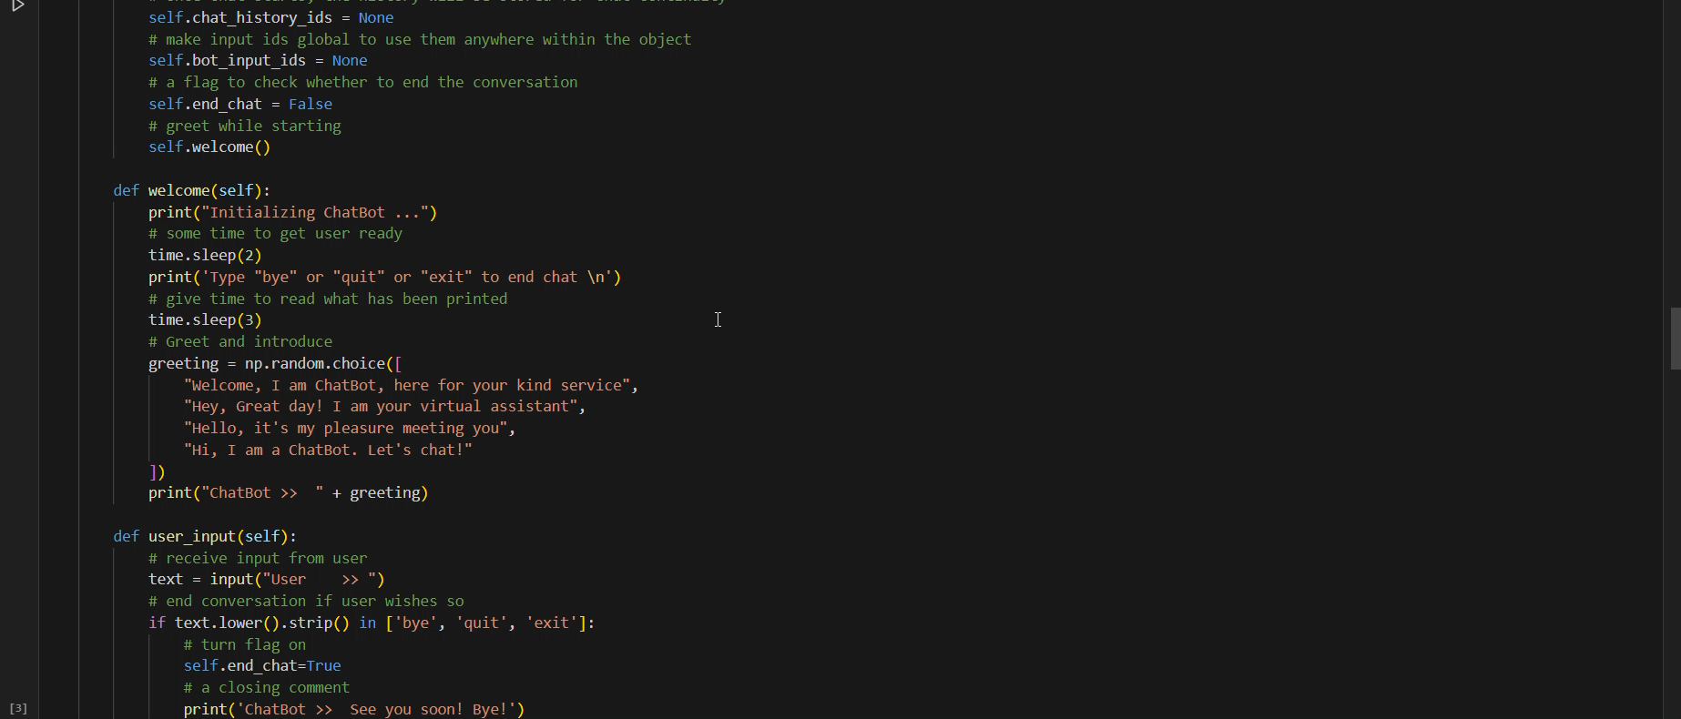
Live Demo of Project

Slide 9
Conclusion
AI chatbots represent a transformative technology that enhances user experiences across various industries by enabling efficient, automated, and interactive communication. They leverage advanced natural language processing (NLP) models and machine learning algorithms to understand user input and generate relevant, human-like responses. The future of AI chatbots holds great potential for integration across multiple domains like healthcare, education, e-commerce, and accessibility, providing personalized, efficient, and responsive experiences. The ongoing development of emotionally intelligent chatbots, multilingual capabilities, and voice interactions will further broaden their application and impact.AI chatbots are shaping the future of digital communication, and their role is poised to grow as technology evolves

Slide 10
Future Scope
Enhanced Personalization
Multimodal Interaction
Proactive and Autonomous Function
Advanced Natural Language Understanding
Human-AI Collaboration
Improved Security and Compliance

Slide 11
Thank you!
Notes:
thank you very much for joining this PPT, keep learning.
11

